Slide 1



ATTENTION MODELING AND USER POLLING FOR CONTINUOUS SENSING
ML-based Distributed Decision Making with Convergent
Replicated Data Types:
An Application for Distributed Pollution Monitoring
M.Tech Project
Under the supervision of
Asst.Prof.Sandip Chakraborty
Department of Computer Science and Engineering
Indian Institute of Technology Kharagpur
Presented by: Amit Kumar
20CS30003
Dr.Sandip Chakraborty
Department of Computer Science and Engineering
Indian Institute of Technology, Kharagpur
Notes:
Good Morning everyone, I am Amit Kumar. I have done my master thesis project under Dr. Sandip Chakraborty. My project title is ML-based Distributed Decision Making with Convergent Replicated Data Types

Slide 2



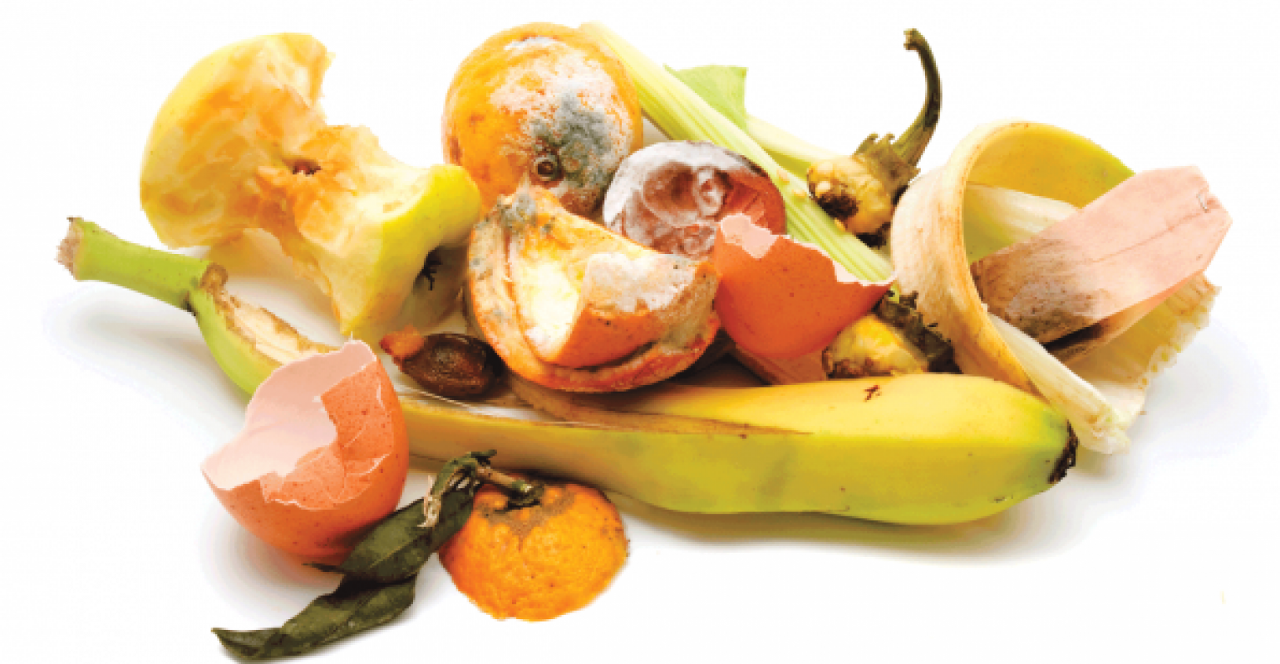
Indoor Pollution & Air Quality Monitors
CO₂
CO₂
PM
PM
Household air pollution(WHO Report):
estimated 3.2 million deaths per year in 2020
including over 237,000 deaths of children under the age of 5
Low cost air quality monitors:
isolated measurements (location dependent)
fail to capture complex dynamics of air pollution propagation across interconnected indoor spaces.
VOC
VOC
C₂H₅OH
NO₂
VOC
NO₂
FDH
Image sources: https://www.flaticon.com/
Notes:
Household air pollution was responsible for an estimated 3.2 million deaths per year in 2020, including over 237 000 deaths of children under the age of 5. The use of low-cost air quality monitors in indoor spaces is beneficial for individual awareness. It primarily focused on isolated measurements which fail to capture complex dynamics of air pollution propagation across interconnected indoor spaces.

Slide 3
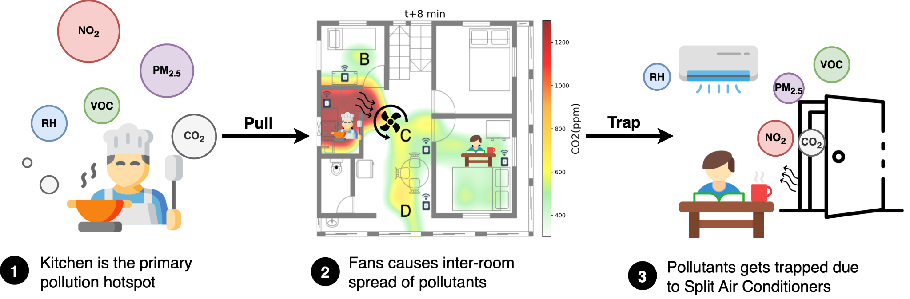
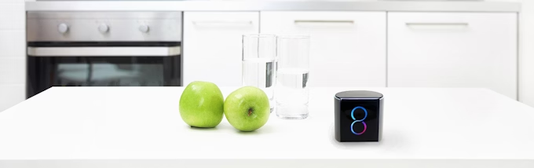
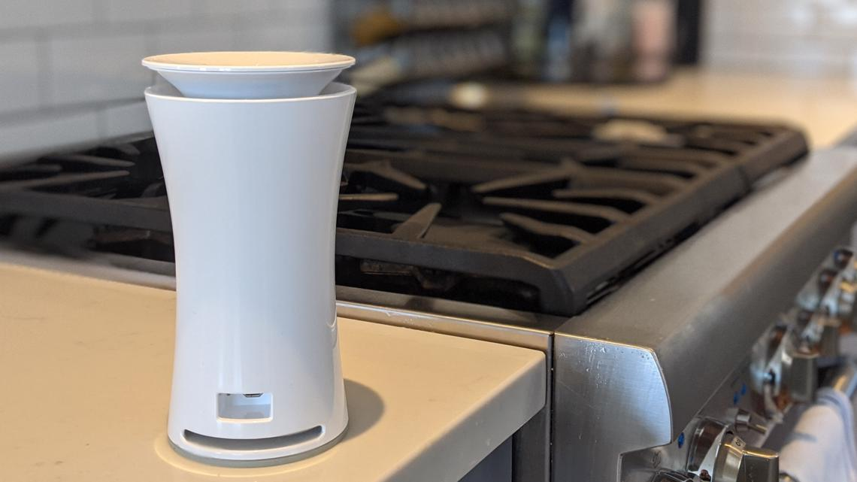
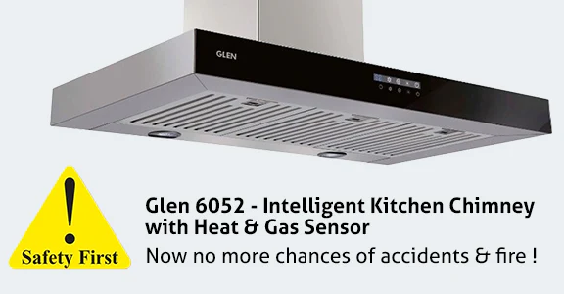
Air Pollution Propagation
Different sensor(location) sense the same activity at different time. How Real time ?
Can we exploit the location specific informations from the different areas of the house to keep a global context?
How it can help?
Air management strategies eg. exhaust on/off
Preventive actions eg. fire
current monitoring systems lack the capability to track propagation patterns or provide timely, coordinated responses
Image sources: https://www.flaticon.com/
Notes:
This is how air pollution from kitchen can propagate to the other areas of the house. Can we use different sensors data to keep a global view of the system? We can track real time activities within the house. This system can be used for improved air management strategies within households. For example, in the event of a fire, early pollutant propagation detection across sensors could trigger timely alerts and preventive actions. By providing occupants with actionable insights on ventilation and air quality, our system fosters healthier indoor environments.

Slide 4
Air Pollution Propagation
Objective of the study
Develop distributed system architecture that transforms standalone air quality monitors into a coordinated network of air quality monitors.
How?
ESP32-based monitoring device (DALTON^{[1]})
consistent global context across all monitors
SetCVRDT (Conflict-free Replicated Data Type)
prediction updated by each node with time. Sequence of updates may not be same.
distributed coordination and decision making
Raft consensus algorithm
ESP-32 - Limited resources
Different decision making (lagging behind)
ML models to predict real-time activity detection
[1] Karmakar, P., Pradhan, S. and Chakraborty, S., 2023. Exploring Indoor Health: An In-depth Field Study on the Indoor Air Quality Dynamics. arXiv preprint arXiv:2310.12241.
Image sources: https://www.flaticon.com/
Notes:
We require dalton
We require setcvrdt -> why? Each node can update their data structure storing all predictions any time. The same should be reflected in all the nodes. First an earlier predicoitn will be deleted and a new prediction will be added. We want this datstrucure to be consistent. We don’t want different sets of predictions among different monitors. To have this we used setcvrdt Rsft-> for decision making. There can be monitors which is lagging behind from others. Is not able to capture the correct packets sent by others. If that happens then a wrong prediction cna cause lots of mishappening. So, we require a leader among them which will take all necessary decision. Another erason sbeing is the limitation to computation power of esps-32
What is our objective? How will we achieve this? A sensor far away from door would never be able to detect that door was open or not. So, we need a global context. Various other reasons as well.

Slide 5
Information Flow
Air monitoring sensor (DALTON^{[1]}) capture the Air composition.
Individual nodes(ESP32 microcontroller) use local ML models to generate activity predictions based on the Air composition.
The Raft-elected leader processes the aggregated predictions
Predictions are shared across nodes using Set CvRDT module.
[1] Karmakar, P., Pradhan, S. and Chakraborty, S., 2023. Exploring Indoor Health: An In-depth Field Study on the Indoor Air Quality Dynamics. arXiv preprint arXiv:2310.12241.
Notes:
implement a State-based Conflict-free replicated data type(CvRDT) system using the set data structure.
Two endpoints to be made available by each node to receive insert and remove items requests from the main_set that is stored locally.
● When an item is inserted to the set using the /add endpoint, the item must reflect in other nodes' set too.
● When an item is removed from the set using the /rem endpoint, the item must be removed from the other nodes' set too.
Unique associated with each new insertions ensures concurrent reinsertions at multiple nodes.

Slide 6
Set Cvrdt Module
Implement
State-based Conflict-free replicated data type system using the set data structure.
Each node to receive insert and remove items requests from the main_set that is stored locally.
Requires
When an item is inserted to the set using the /add endpoint, the item must reflect in other nodes' set too.
When an item is removed from the set using the /rem endpoint, the item must be removed from the other nodes' set too.
What items are we storing
Unique id(ip address + random number), Activity prediction at each sensors.
Properties
Convergence (same state)
Commutativity (order of operation)
Associativity (grouping/rearranging)
Idempotency (reinsertion, redeletion)
Testing
Multiple Instance Deletion Problem
Multiple Node Insert-Remove Operations
Concurrent Reinsertion at nodes
Multiple remove and add in parallel.
Notes:
implement a State-based Conflict-free replicated data type(CvRDT) system using the set data structure.
Two endpoints to be made available by each node to receive insert and remove items requests from the main_set that is stored locally.
● When an item is inserted to the set using the /add endpoint, the item must reflect in other nodes' set too.
● When an item is removed from the set using the /rem endpoint, the item must be removed from the other nodes' set too.
Unique associated with each new insertions ensures concurrent reinsertions at multiple nodes.

Slide 7
Raft
Implement
For leader election.
Instead of all nodes processing and analyzing the global state, the elected leader takes primary responsibility for complex decision-making.
This is particularly important for resource-constrained ESP32 devices
Fire → Necessary precautions
Leader:
Sends heartbeat
Broadcasts decisions to all follower nodes.
Node states
Follower, Candidate, Leader
Election Process
Node discovery by joined message.
Voting mechanism: Self voting, Vote request broadcasting, processing
Testing and challenges
Infinite election problem: Term number in elections with no result.
Three node configuration
four node configuration.
Shutting down follower, leader and turning it on , multiple times.
Notes:
While Set CvRDT ensures all nodes maintain consistent state of detected activities, Raft’s leader election mechanism ensures centralized decision-making.
What action should be taken based on global context. Instead of all nodes processing and analyzing the global state, the elected leader takes primary responsibility for complex decision-making.
The leader node becomes responsible for aggregating activity predictions from all nodes and making final determinations about ongoing activities. Like fire in the building. Then necessary precautions will be taken from leader node. This is particularly important for resource-constrained ESP32 devices, as it prevents redundant processing across nodes.
Node states and Role: Follower, Candidate, Leader.
: Term management, Vote request broadcasting, Voting mechanism(self voting, vote request processing), Leader operations: heartbeat and state Coordination
UDP Communication
Node discovery by joined message. Testing and challenges: Infinite election problem: Not incrementing term number on no result election.
Three node configuration and four node configuration. Shutting down leader and turning it on. Shutting down follower and turing it on.

Slide 8
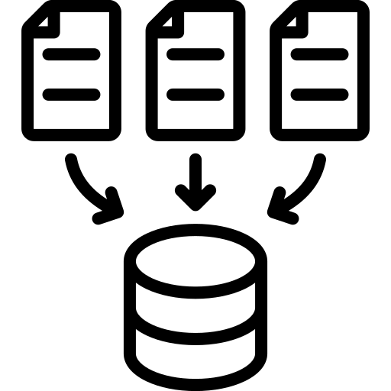
Data Collection
Lab Activity Dataset ^{[2]}
A three-month study conducted in an academic research laboratory setting
To see the correlation between indoor activities and air composition. We can use this for precautions and decision making.
Cooking Dataset ^{[3]}
comprising cooking type and food measurements from a kitchen in a suburban food canteen in India.
To see whether smaller changes air composition can be easily predicted or not. We can use this for notifications (What's being cooked right now).
[2] Prasenjit Karmakar, Swadhin Pradhan, and Sandip Chakraborty. 2024. Exploiting Air Quality Monitors to Perform Indoor Surveillance: Academic
Setting. In 26th International Conference on Mobile Human-Computer Interaction (MOBILEHCI Adjunct ’24), September 30–October 03, 2024, Melbourne, VIC, Australia. ACM, New York, NY, USA, 6 pages. https://doi.org/10.1145/ 3640471.3680243
[3] Sandip Chakraborty Prasenjit Karmakar, Swadhin Pradhan. Indoor air quality dataset with activities of daily living in low to middle-income communities. arXiv:2407.14501, v3, 2024.
Image sources: https://www.flaticon.com/
Notes:
While Set CvRDT ensures all nodes maintain consistent state of detected activities, Raft’s leader election mechanism ensures centralized decision-making.
What action should be taken based on global context. Instead of all nodes processing and analyzing the global state, the elected leader takes primary responsibility for complex decision-making.
The leader node becomes responsible for aggregating activity predictions from all nodes and making final determinations about ongoing activities. Like fire in the building. Then necessary precautions will be taken from leader node. This is particularly important for resource-constrained ESP32 devices, as it prevents redundant processing across nodes.
Node states and Role: Follower, Candidate, Leader.
: Term management, Vote request broadcasting, Voting mechanism(self voting, vote request processing), Leader operations: heartbeat and state Coordination
UDP Communication
Node discovery by joined message. Testing and challenges: Infinite election problem: Not incrementing term number on no result election.
Three node configuration and four node configuration. Shutting down leader and turning it on. Shutting down follower and turing it on.

Slide 9

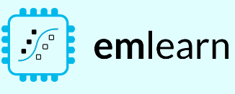

ML Model | ESP-32 | Emlearn Library
ML-Models used
Decision Trees, Random Forest, Extra Trees, Gaussian Naive Bayes, Neural Network (sklearn mlp)
Why Emlearn Library
We cannot train ML-models on ESP-32
Converts ML Models to efficient C code.
Easy to deploy to any microcontroller with c99 compiler
Challenges
ESP-32 supports only 16 bit integers
floating point operations till 1 decimal place (Very inefficient).
Data Processing
Converted the Air composition(input data) values from floating point to integral values within the 16 bit range.
Image sources: https://www.flaticon.com , https://emlearn.readthedocs.io/en/latest/source/README.html
Notes:
Emlearn is an open-source Python library that allows converting scikit-learn and Keras models to efficient C code. This makes it easy to deploy to any microcontroller with a C99 compiler, while keeping Python-based workflow that is familiar to Machine Learning Engineers.

Slide 10
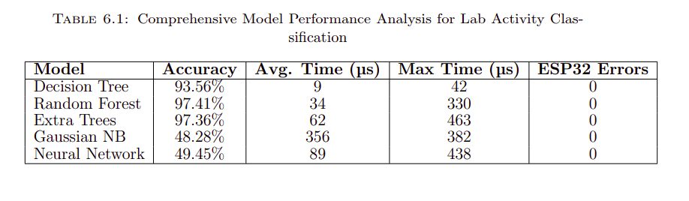
Results - Lab Activity
Notes:
Emlearn is an open-source Python library that allows converting scikit-learn and Keras models to efficient C code. This makes it easy to deploy to any microcontroller with a C99 compiler, while keeping Python-based workflow that is familiar to Machine Learning Engineers.

Slide 11
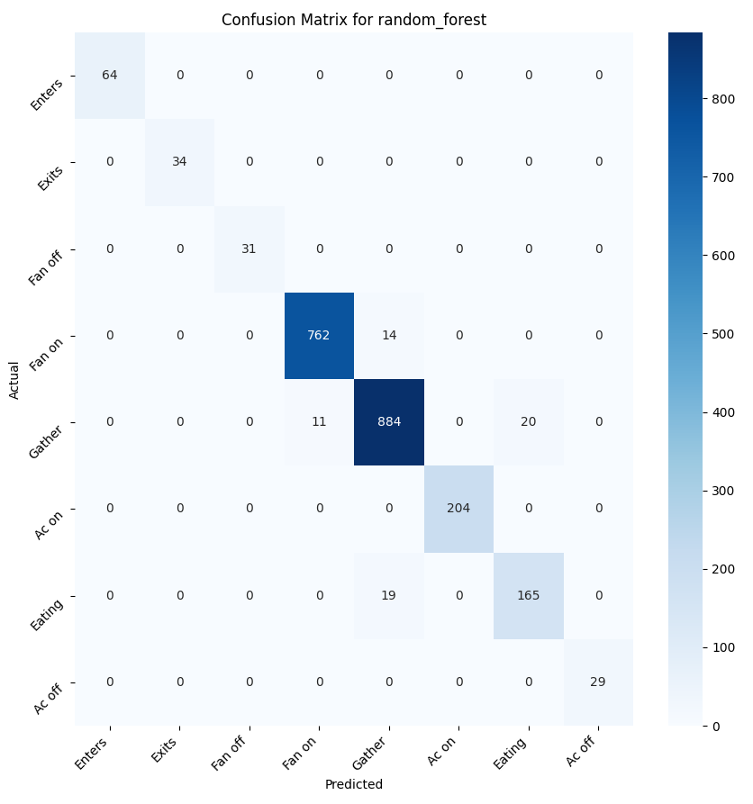
Results - Lab Activity
Confusion Matrix for
Random Forest
Notes:
A confusion matrixis a two-dimensional matrix used in classification experiments to evaluate the performance of a system by showing the number of correctly and wrongly classified data

Slide 12

Results - Lab Activity
Confusion Matrix for
Decision Trees
Notes:
A confusion matrixis a two-dimensional matrix used in classification experiments to evaluate the performance of a system by showing the number of correctly and wrongly classified data

Slide 13

Results - Lab Activity
Confusion Matrix Extra Trees
Notes:
A confusion matrixis a two-dimensional matrix used in classification experiments to evaluate the performance of a system by showing the number of correctly and wrongly classified data

Slide 14
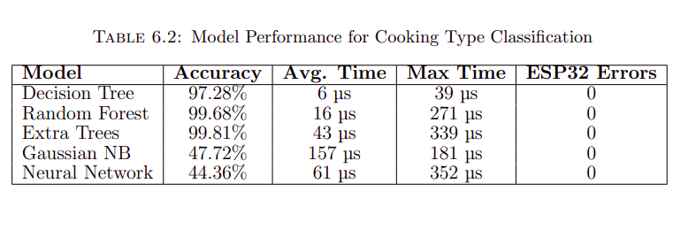
Results - Cooking Activity (Cook_Type)
Notes:
Emlearn is an open-source Python library that allows converting scikit-learn and Keras models to efficient C code. This makes it easy to deploy to any microcontroller with a C99 compiler, while keeping Python-based workflow that is familiar to Machine Learning Engineers.

Slide 15
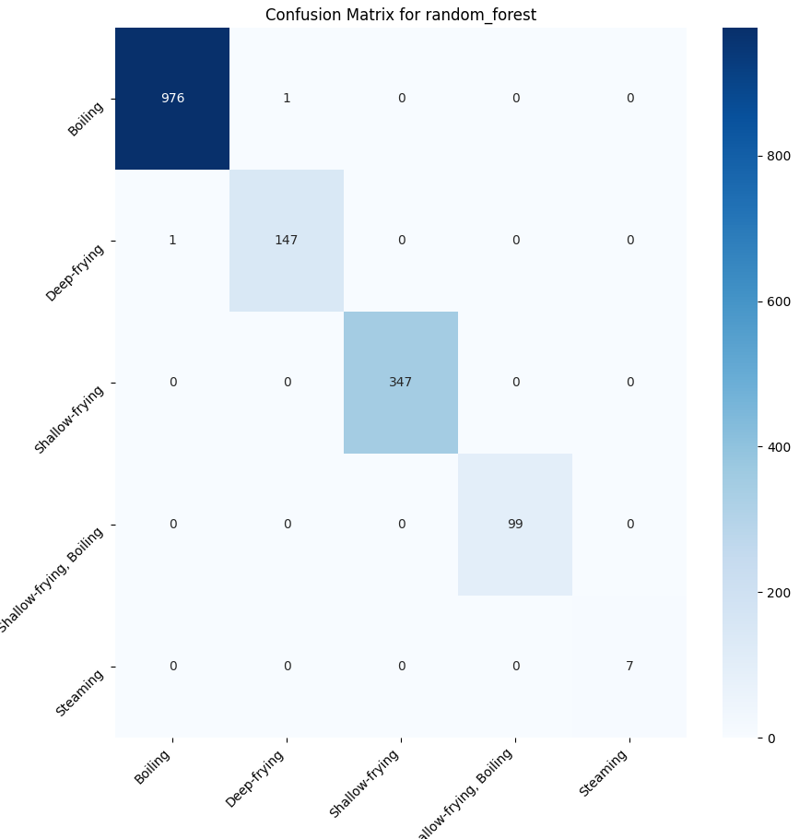
Cooking Activity
(Cook_Type)
Confusion Matrix for
Random Forest
Notes:
A confusion matrixis a two-dimensional matrix used in classification experiments to evaluate the performance of a system by showing the number of correctly and wrongly classified data

Slide 16
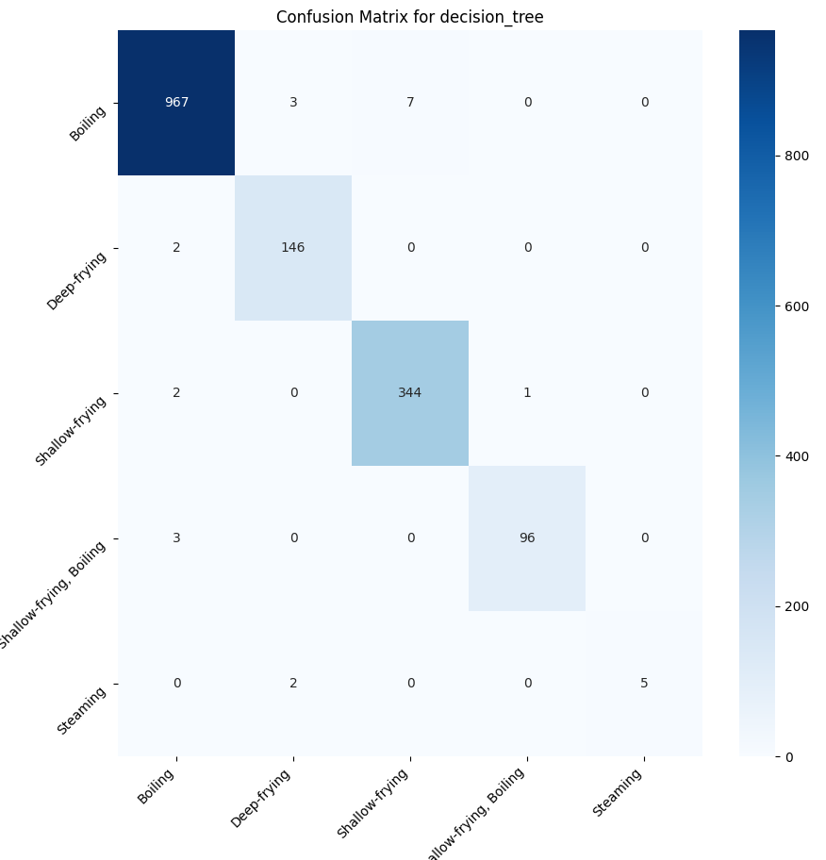
Cooking Activity
(Cook_Type)
Confusion Matrix for
Decision Trees
Notes:
A confusion matrixis a two-dimensional matrix used in classification experiments to evaluate the performance of a system by showing the number of correctly and wrongly classified data

Slide 17
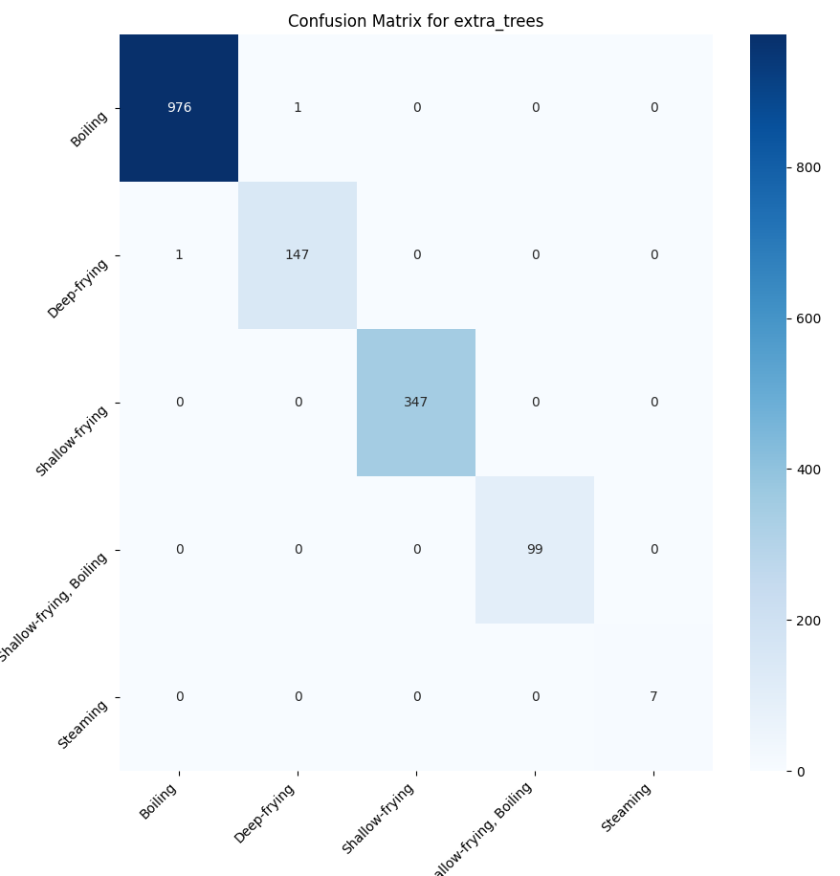
Cooking Activity
(Cook_Type) Confusion Matrix for Extra Trees
Notes:
A confusion matrixis a two-dimensional matrix used in classification experiments to evaluate the performance of a system by showing the number of correctly and wrongly classified data

Slide 18
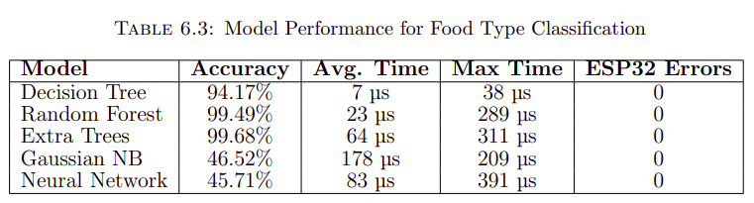
Results - Cooking Activity (Food_Type)
Notes:
Emlearn is an open-source Python library that allows converting scikit-learn and Keras models to efficient C code. This makes it easy to deploy to any microcontroller with a C99 compiler, while keeping Python-based workflow that is familiar to Machine Learning Engineers.

Slide 19
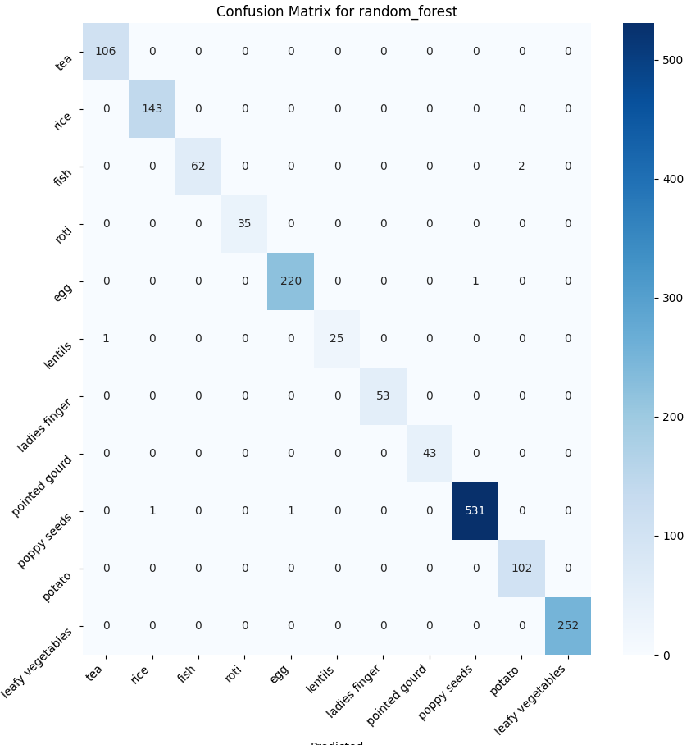
Cooking Activity
(Food_Type)
Confusion Matrix for
Random Forest
Notes:
A confusion matrixis a two-dimensional matrix used in classification experiments to evaluate the performance of a system by showing the number of correctly and wrongly classified data

Slide 20

Cooking Activity
(Food_Type) Confusion Matrix for
Decision Trees
Notes:
A confusion matrixis a two-dimensional matrix used in classification experiments to evaluate the performance of a system by showing the number of correctly and wrongly classified data

Slide 21

Cooking Activity
(Food_Type) Confusion Matrix for Extra Trees
Notes:
A confusion matrixis a two-dimensional matrix used in classification experiments to evaluate the performance of a system by showing the number of correctly and wrongly classified data

Slide 22
Gaussian Naive Bayes, sklearn mlp
While previous research^{[2]} demonstrated high accuracy with (64,64)-neuron hidden layers (achieving 97.7% accuracy), EmLearn’s C code generation limitations forced us to use a reduced architecture (10,10 neurons hidden layers) for ESP32 deployment .
Despite successful deployment, this reduced architecture showed poor performance (around 45% accuracy) due to less number of hidden layers.
Floating-Point Operations: Both Neural Network and Gaussian NB struggled with ESP32’s floating point limitations, showing significantly higher prediction times and poor accuracy. The necessary integer conversion of sensor data further impacted model performance.
[2] Prasenjit Karmakar, Swadhin Pradhan, and Sandip Chakraborty. 2024. Exploiting Air Quality Monitors to Perform Indoor Surveillance: Academic
Setting. In 26th International Conference on Mobile Human-Computer Interaction (MOBILEHCI Adjunct ’24), September 30–October 03, 2024, Melbourne, VIC, Australia. ACM, New York, NY, USA, 6 pages. https://doi.org/10.1145/3640471.3680243
Notes:
To conclude

Slide 23
Conclusion
Successfully implemented and tested three key components that can work together to create a robust and efficient system:
Set CvRDT: ensures consistent data sharing across distributed nodes.
Raft Consensus Algorithm: enables reliable leader election and coordinated decision making.
Machine Learning Models: successfully implemented and validated multiple machine learning models on ESP32 devices using the EmLearn library. The most efficient model, Random Forest, achieved over 97% accuracy for lab activity detection and 99% for cooking activity detection, while maintaining minimal prediction times suitable for real-time operation
Notes:
To conclude

Slide 24


Scope of Future Work
Yogdaan
02
Dataset Enhancement
02
System Integration
Expanding the dataset to include more diverse activities. Currently lab activity dataset has only 8 activity.
01
Implementing unified codebase combining Set CvRDT, Raft, and ML models on ESP-32
04
using bluetooth
04
Currently we are using common wifi for communication for UDP.
Low power consumption.,
Low latency in short range,
Better for periodic transfers,etc.
03
Real-world Deployment
03
Testing in various residential and commercial settings. Gathering user feedback for system refinement.

Slide 25
References
THANK YOU

